Slide 1
About Me
Ritesh Singh
Sun Certified java Professional
Oracle Certified Database Administrator
Certified Ethical Hacker
Certified EC-Council Instructor (CEI)

Slide 2
Course Overview
Introduction to Introduction to the INTERSECT operator

Slide 3
The INTERSECT operator is a set operator that returns only distinct rows of two queries or more queries.
The following illustrates the syntax of the INTERSECT operator.
(SELECT column_list
FROM table_1)
INTERSECT
(SELECT column_list
FROM table_2);
The INTERSECT operator compares the result sets of two queries and returns the distinct rows that are output by both queries.

Slide 4
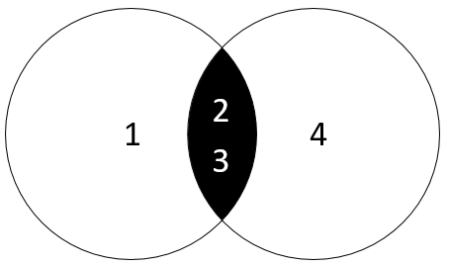
To use the INTERSECT operator for two queries, you follow these rules:
The order and the number of columns in the select list of the queries must be the same.
The data types of the corresponding columns must be compatible.
The following diagram illustrates the INTERSECT operator.

Slide 5
The left query produces a result set of (1,2,3).
The right query returns a result set of (2,3,4).
The INTERSECT operator returns the distinct rows of both result sets which include (2,3).
Unlike the UNION operator, the INTERSECT operator returns the intersection between two circles.
Note that the SQL standard has three set operators that include UNION, INTERSECT, and MINUS.

Slide 6
Emulating INTERSECT in MySQL
Unfortunately, MySQL does not support the INTERSECT operator. However, you can emulate the INTERSECT operator.
Setting up sample tables
The following statements create tables t1 and t2, and then insert data into both tables.
CREATE TABLE t1 (
id INT PRIMARY KEY
);
CREATE TABLE t2 LIKE t1;
INSERT INTO t1(id) VALUES(1),(2),(3);
INSERT INTO t2(id) VALUES(2),(3),(4);

Slide 7
The following query returns rows from the t1 table.
SELECT id FROM t1;
id
----
1
2
3

Slide 8
The following query returns the rows from the t2 table:
SELECT id
FROM t2;
id
---
2
3
4

Slide 9
1) Emulate INTERSECT using DISTINCT and INNER JOIN clause
The following statement uses DISTINCT operator and INNER JOIN clause to return the distinct rows in both tables:
SELECT DISTINCT
id
FROM t1
INNER JOIN t2 USING(id);
id
----
2
3

Slide 10
How it works.
The INNER JOIN clause returns rows from both left and right tables.
The DISTINCT operator removes the duplicate rows.
2) Emulate INTERSECT using IN and subquery
The following statement uses the IN operator and a subquery to return the intersection of the two result sets.
SELECT DISTINCT id
FROM t1
WHERE id IN (SELECT id FROM t2);
id
----
2
3

Slide 11
How it works.
The subquery returns the first result set.
The outer query uses the IN operator to select only values that exist in the first result set. The DISTINCT operator ensures that only distinct values are selected.

Slide 12
Thank You
Please Subscribe My Channel
https://www.youtube.com/channel/UCYW3PWPOPn3qgxxjhUbXXXg?view_as=subscriber

